Slide 1
LMS has two set of repositories
Machon Yael – MY
Repositories:
my-*
my-mobile ( Mobile app)
my-userapp (API – php)
my-user-portal (Student portal)
my-admin-portal (School manager portal)
LMS – for all other customers
Repositories:
LMS-*
lms-mobile (Mobile app)
lms-userapp (API – php)
lms-video (Student portal)
lms-backoffice (School manager portal

Slide 2








lms-backoffice repository
Main page - LMS
Features
Prices
Live Example
Login
Free Trial
Host, Manage, Protect, Control and Sell your course offerings.
Suitable for Online schools, Employee trainings and in-depth product guidance
60
Try 14 days – Risk free
In about
Seconds
You can have your own online course offerings – online !
The most comprehensive and secured training platform
Follow us

Slide 3


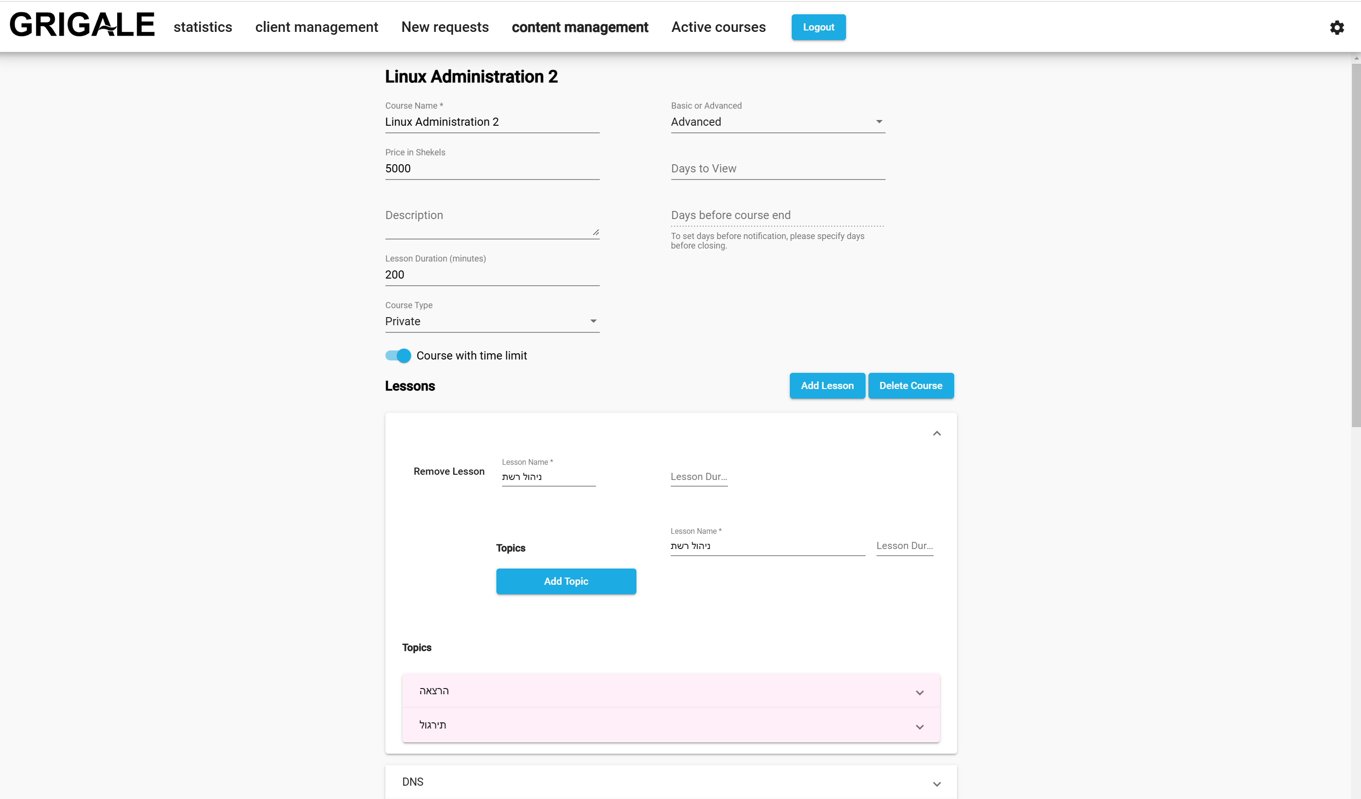
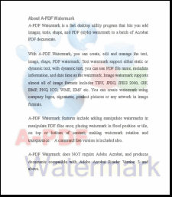



lms-backoffice repository
Features page - LMS
Features
Prices
Live Example
כניסה לאתר הלימודים
Free Trial
Host your courses.
Manage your own customers.
Protect your content.
Try 14 days – Risk free
“Perfect for hosting all my courses and controlling thousands of students”
Been using it for more than 5 years while managing
more than several dozens of courses and thousands
of students, while protecting my content and
providing great satisfaction for my customers.
YAELINSTITUTE
Yael K.
Fashion design & Modelling
Create your Courses,
Lessons and Subjects
Add videos, slides and PDF files.
.
Private Video content – supporting YouTube, Vimeo, Spotlightr.
PDF files – can be password protected and marked with dynamic user identification watermark.
Protected Content - User can view course content from only one computer.
Limit View Time - Timer can be configured for protecting unauthorized viewing.
Sell You Courses – Online shop for selling your course offerings.
Complementary Online Shop – For selling other complementary products along with your courses.

Slide 4
lms-backoffice repository
Prices page - LMS
i
Features
Prices
Live Example
Login
Free Trial
CORE
PRO
PREMIUM
SCALE
49$/month
1 Course
Additional course – 30$
10 users
Additional user – 5$
149$/month
5 Course
Additional course – 30$
Up to 50 users
Additional user – 5$
499$/month
20 Course
Additional course – 30$
Up to 100 users
Additional user – 5$
Need more ?
Unlimited Courses
Up to 1000 users
Start with free plan
Start with free plan
Start with free plan
Contact sales
The most comprehensive and secured training platform
Follow us

Slide 5
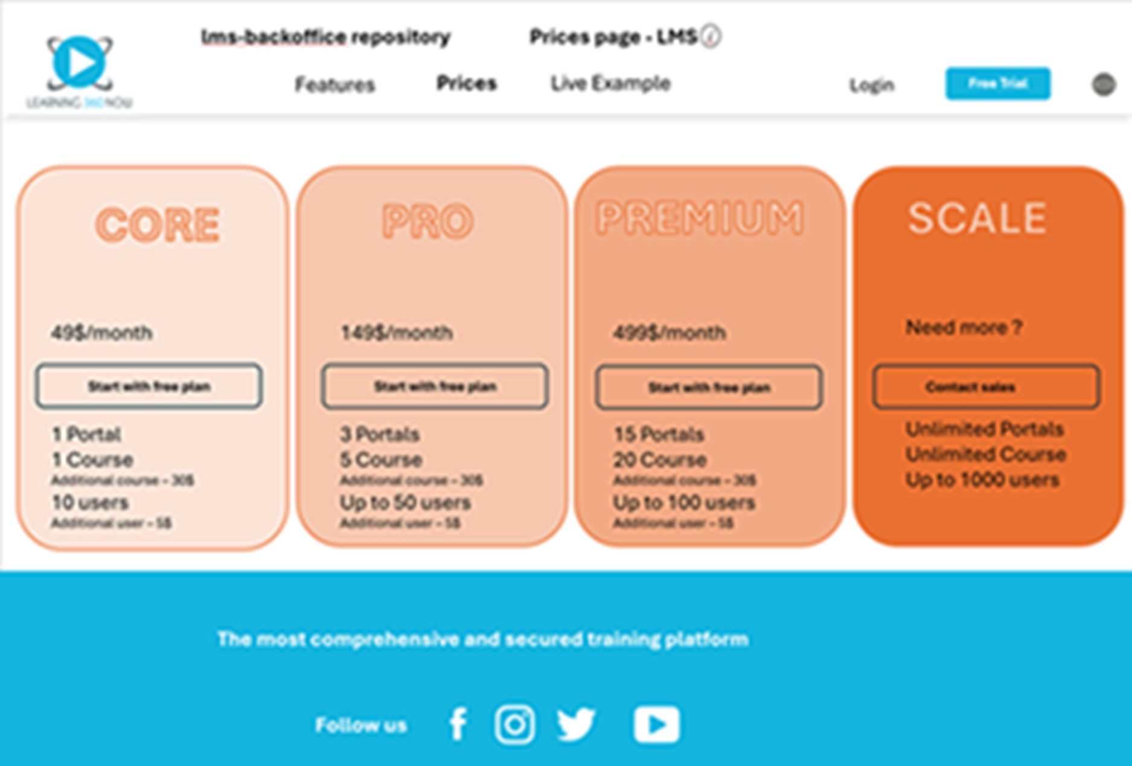
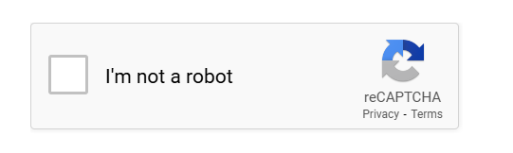
lms-backoffice repository
Free Trial page - LMS
Features
Prices
Live Example
Login
Free Trial
1
2
Your Details
Organization Details
Your Name
Your Email Address
Password
Continue
G
Sign Up With Google

Slide 6

1
2
Your Details
Organiation Details
Online site
Your Organization name
.learning360now.com
Admin site
Your Organization name
-admin.learning360now.com
Insert
Your
Logo
Choose
Buttons
Color
Choose
Background
Color
default size: 512X512
Start your Trial

Slide 7
lms-backoffice repository
Login page for the Admin site - LMS
Features
Prices
Live Example
Login
Free Trial
Email
Password
Login
G
Sign Up With Google

